Slide 1

Smart home
Done by:
Amer farg
Basel Medhat
Mark amged
Nour Hesham
Noureldein Ahmed

Slide 2
Smart home Outlines
Idea of the Project
Project Requirements
Components
Flowchart
Simulation

Slide 3
Idea of the project
This project is a smart home application that aims to transform an ordinary home into a smart and controllable home. Many home appliances such as lamps, door, and air conditioning can be controlled using a smartphone or laptop remotely. The system also provides additional means of control for emergency situations or when a phone or laptop is not available, such as using the LCD screen and keypad.

Slide 4
Idea of the project
The project has an admin and user login system, where the admin can register a new user or remove an existing user. Usernames and passwords are stored in memory even when the system is turned off. If passwords are entered incorrectly more than 3 times, the system will stop and sound the alarm.

Slide 5
Idea of the project
Users can control the system using the keypad or remote interface, with the exception of door opening which is only available to admin. The current hardware status is also displayed on the LCD screen.

Slide 6
Requirements
The project requirements for this smart home application are
Remote Control: The system must be controllable remotely
Emergency Control: In case of emergencies or when remote control is not available, the system should offer control through an LCD and Keypad interface, specifically in user mode.
Controllable Devices:
6 LEDs: 5 LEDs with on/off functionality and 1 dimmable LED. - Door: To control the opening and closing. - Air-conditioner: Control based on ambient temperature.
Login System:- Admin and User login: Admin access is remote only. - Admin mode can register or remove users.

Slide 7
Requirements
User Authentication: - Usernames and passwords must be stored in memory, persisting even if the system is powered off. - If incorrect login attempts exceed 3 trials, the system should lock down and activate a fire alarm until reset.
Access Control: - Admin and User can access all functions except user cannot control door opening. - Users can control the system remotely even if the admin logs in remotely, except when admin disallows it.
LCD Interface: - The LCD must display running devices if the Keypad-LCD system is not used.
Usernames : Usernames in this system are different from those used for remote access.
EEPROM Specifications :Transmitting/Receiving between the microcontroller (MC) and PC/mobile. - Messages must be printed on Mobile/PC screens. - Transmitting/Receiving commands to run the system.
LEDs and Dimmer: 5 LEDs and 1 dimming LED is required

Slide 8
Requirements
Door Actuator: - Servo motor controls the door opening, exclusively in admin mode, based on commands sent
. Temperature Sensor and DC Motor: Temperature sensor to read ambient temperature. Air conditioner control: DC motor activates.

Slide 9
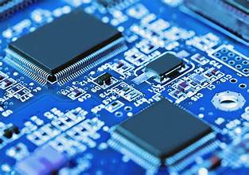
Smart home comonent
2 Atmega32
Servo motor
6 LEDs
Keypad
2 LCDs
DC motor

Slide 10
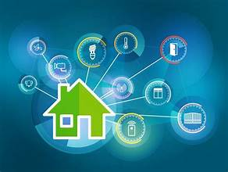
Smart home component
LM 35 (temperature sensor)
Buzzer
Button

Slide 11
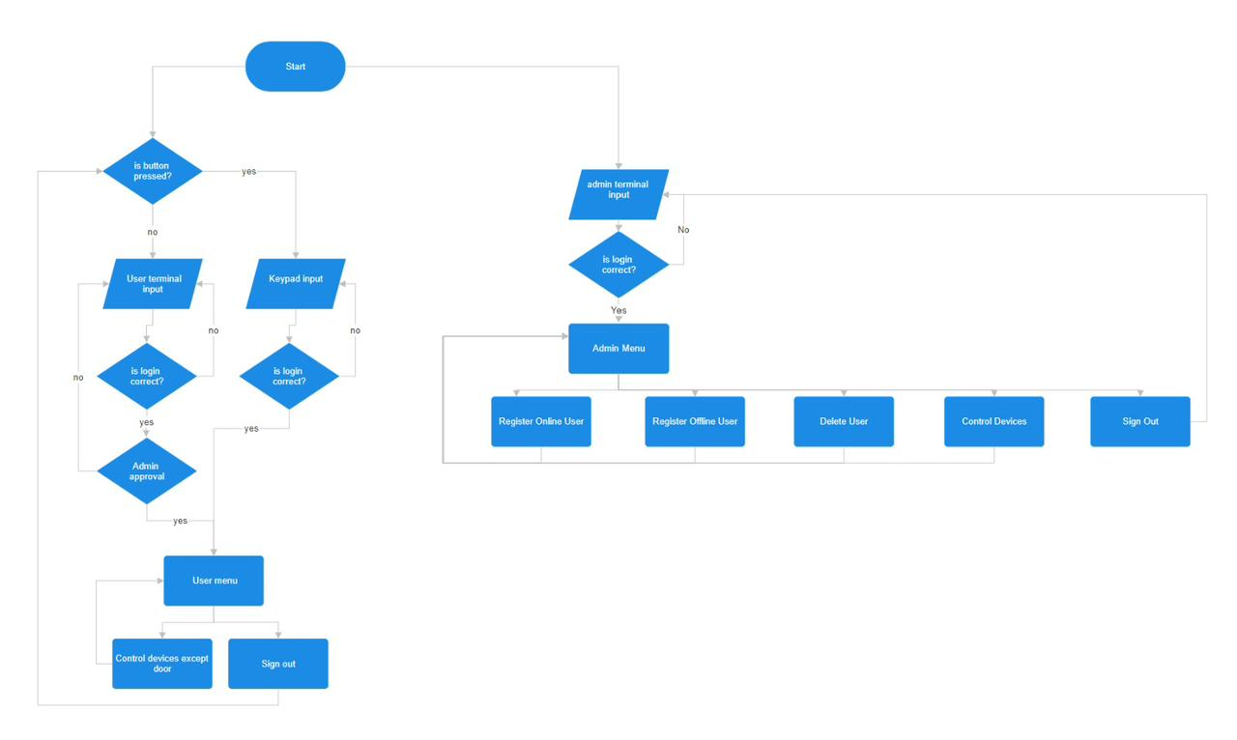
Smart home flow chart

Slide 12
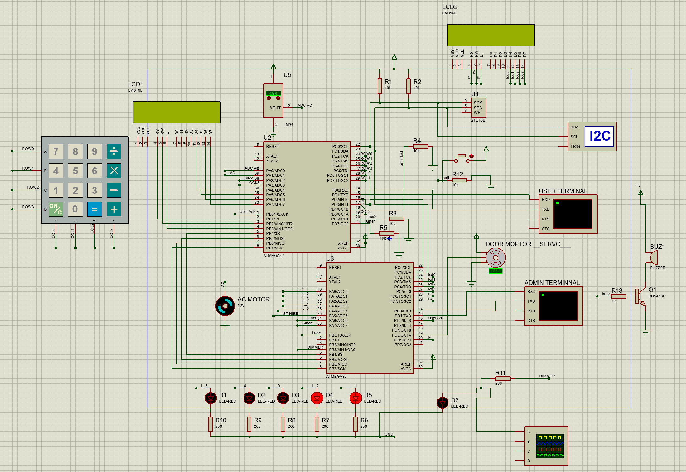
Simulation

